Slide 1
VARIABLES
A Variable has a name and type , used to hold some data temporarily.
The value of a variable can be altered / modified later at any time in the program.
Declaration of a variable:
Syntax: <data type > <variable-name>;
  Ex: - int a, b, c;
In the above declaration a, b and c are integer variables which can store some integer data.
  Ex:- float c, d, e;
In the above declaration c, d and e are float variables which can store some real data

Slide 2
Initialization of a variable:
int a,b,c; // a, b, c are declared
a=10; b=20; c=30; // a,b,c are initialized with some values , this kind of initialization is called as static initialization .
a,b,c can also be initialized dynamically( at run time).
scanf(“%d%d%d”,&a,&b,&c);
Different Types of Variables
Variable scope determines the availability of a variable across functions.
A variable can be declared in two scopes:
  Local variable scope and
  Global variable scope
Global variable
Local variable
Automatic variable
Static variables

Slide 3
1.Global variables—the variables, which are declared outside all the functions (including the main) is, called as global variable. They are available to all the functions.
Ex: - int a;
float b;
void main()
{ int c;
char d;
}
In the above example a, b are global variables, c,d are local variables.
2.Local variables—the variables, which are declared within a function, are called local variables. They can be used only within the function in which it is declared.

Slide 4
3.Automatic variables—they are created when the function block is entered and removed when the function is terminated. By default, all the variables are automatic variables.
Ex: main()
{ int a;
static int b;
}
In the above example int a can also be considered as auto int a which means all local variables are automatic by default as they are created and deleted automatically.
The variable b is a static variable whose value will be persistent in between the function calls.
4.Static variables—they are variables, which are declared local to a function. However they are available even outside the function in which they are declared.

Slide 5
/* program to swap 2 variables using third variable */
#include<stdio.h>
#include<conio.h> // inclusion of header files
void main() // entry point for execution
{
int a,b,temp;
printf(“Enter the values for a and b\n”);
scanf(“%d%d”,&a,&b); // reading a,b values at run time
temp = a;
a = b;
b = temp;
printf(“values of a and b after swapping %d %d\n”,a,b);
getch();
}

Slide 6
/* program to swap 2 variables with out using third variable */
#include<stdio.h>
#include<conio.h> // inclusion of header files
void main() // entry point for execution
{
int a,b;
clrscr();
printf(“Enter the values for a and b\n”);
scanf (“%d %d ”,&a ,&b); // reading a ,b values at run time
a = a+b;
b = a-b;
a = a-b;
printf(“values of a and b after swapping %d %d\n”,a,b);
getch();
}

Slide 7
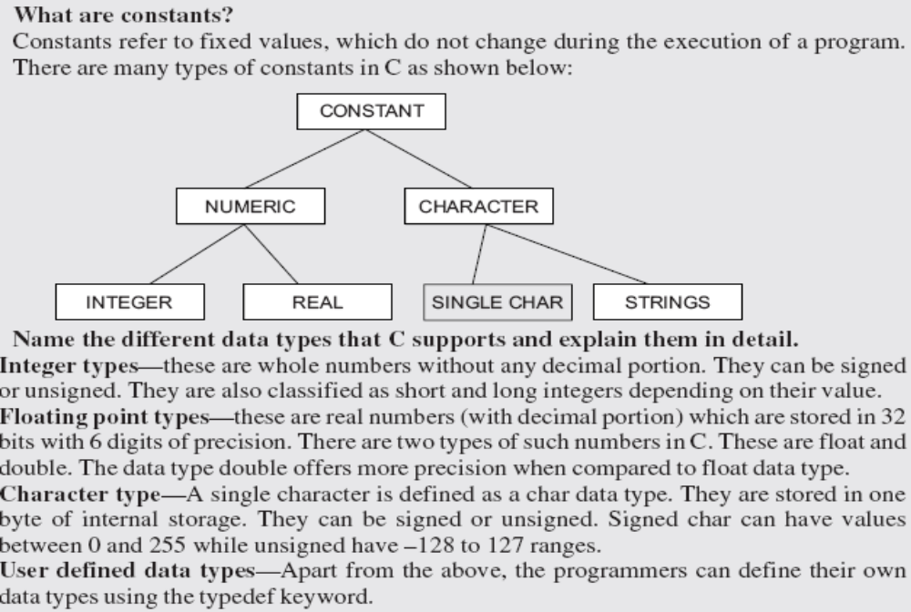
CONTANSTS

Slide 8
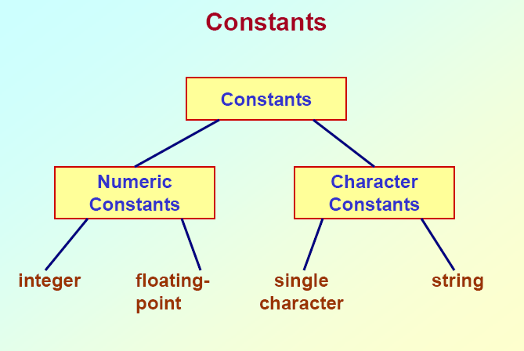

Slide 9
Three ways constants can be defined in a C program
i) using # define
ex:- #define PI 3.14
#define SIZE 200
#define BANNER “WELCOME”
Whenever we use the above constants the occurrence of each PI will be replaced with its value.
ii) using keyword const
const int size=100;
const float pi=3.1432;
iii) using keyword enum
enum day{mon,tue,wed,thu,fri,sat,sun};
enum Boolean {true,false};

Slide 10
C-TOKENS
The smallest element identified by the compiler in a source file is called a token.
It may be a single character or a sequence of characters to form a single item.
Tokens can be classified as keywords, literals, identifiers, operators, etc.
Literals can be further classified as numeric constants, character constants and string constants.

Slide 11
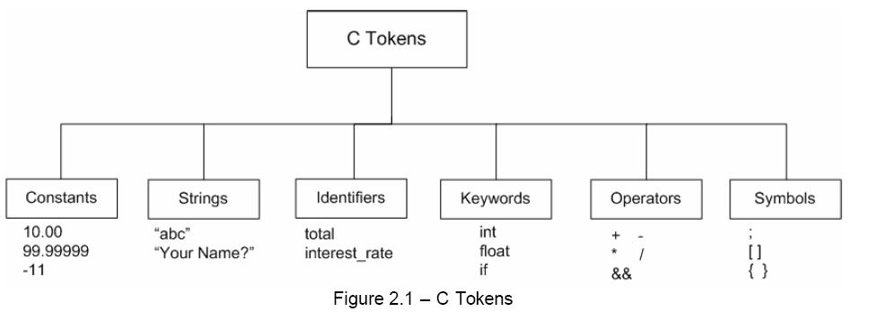

Slide 12
Type Conversions
C is a hard-typed language, meaning that each variable has a fixed type that does not change and which determines the possible assignments and applicable operators
double pi=3.14;
char c=’x’;
Some type conversions occur automatically for example int to float or float to double, but also char to int.
int i = 17;
float x = i; /* assigns 17 to x */
int j = 2;
float y = i/j; /* assigns 17/2 = 8 to y not 8.5 */
Type conversions can be forced by a programmer through
a type cast
float z = (float) i / j; /* casts i into float before division */

